Slide 1
Making Data Science accessible using Raspberry Pi
Level 100

Slide 2
Approach
Capture data by screen scraping web site using node.js
Store data in MySQL
Analyse and forecast data using:
  Spreadsheet statistics and pivots
  Spreadsheet – exponential smoothing
  Forecasting using TensorFlow and Prophet

Slide 3
Goal to track and forecast loading data
Platforms
  Raspberry Pi 3 running Ubuntu 16.04 ARM
  Raspberry Pi 2 Model B running Raspbian
  Surface Book i7 running Ubuntu 16.04 Bash Shell on Windows 10 Pro
  Dell Latitude E5500 running Ubuntu 16.04 Mate
Prerequisites
  Node.js and NPM
  LibreOffice Calc and Base
  Git
  VS Code
  MySQL, MySQL Workbench, PHPMyAdmin, Apache2, Webmin
  Google Tensor Flow
  R, Facebook Prophet, Python

Slide 4
Conclusions for Data Forecasting
Data Function | Raspberry Pi (Raspbian & Ubuntu) | Ubuntu Shell on Windows 10 (x64) | Windows Native | Ubuntu (x86)
Data capture & storage | ✓ | ✗ | ✓ | ✓
Spreadsheet Stats & Pivots | ✓ | n/a | ✓ | ✓
Spreadsheets | ✗ | n/a | ✓ | ✓
TensorFlow (Python) | Feasible but time consuming | ✓ (serialized data only, not time series) | ✓ (serialized data only, not time series) | ✓ (serialized data only, not time series)
FB Prophet (R) | ✗ Raspbian R (3.1.1) does not support Prophet ✗ Ubuntu R (3.2.3) compiler fails out of memory | Ubuntu R (3.3.2) supports Prophet | R (3.3.2) supports Prophet | R (3.3.2) supports Prophet
FB Prophet (Python) | ✗ Compiler fails out of memory | ✗ n/a needs X windows | ✗ Install fails with current bug | ✓

Slide 5
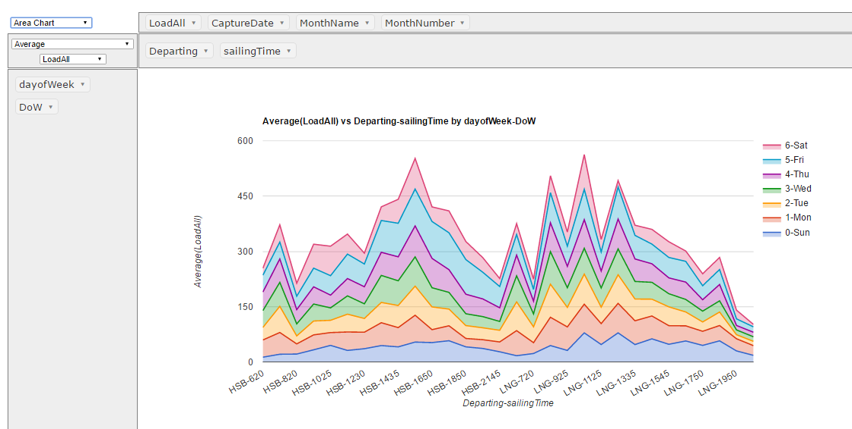
http://localhost/pivot/start.html
http://lexington.atspace.cc/mytemp3_gchart2.html

Slide 7
Parsing logic for scraper
1. Parse page:
http://orca.bcferries.com:8080/cc/marqui/at-a-glance.asp
2. Respective table cells contain strings of the following format:
    http://www.bcferries.com/current_conditions/sailing_detail.html?route=03&amp;dept=LNG&amp;ID=1545&amp;est=85,70,100

Slide 8
References
https://www.sitepoint.com/beginners-guide-node-package-manager/
https://github.com/tensorflow/tensorflow
https://github.com/facebookincubator/prophet

